Slide 1



Financial Database Management
AMUNDI
Karen RAKOTONDRASOA, Mayline SPECHT, Camille CHAPART, Dorine TURON

Slide 2

AMUNDI & ESG DATA CHALLENGES
Amundi :
1 asset manager in Europe
€2,000+ billion AUM
Clients: institutions / companies / individuals
ESG Data Challenges :
Multiple sources
Unstructured data
Not standardized
Different ESG scores
Key Risks :
Greenwashing
Regulatory risk
SFDR
EU Taxonomy
Operational risk (data silos)

Slide 3

How can an investment fund like Amundi guarantee the reliability, integrity, and traceability of ESG data using a robust database system and respecting regulatory requirements?

Slide 4









DATABASE MANAGEMENT SYSTEM
ARCHITECTURE
Data Lake
(use NoSQL Database)
SQL Database
Data Warehouse
DATA FLOW
Data sources
Data Ingestion
Data Lake
(raw ESG Data)
Data Warehouse
(Analysis) + SQL
Data cleaning

Slide 5




REGULATIONS ON AMUNDI’S DATA
Owned by Crédit Agricole (69.2%) : BCBS 239
Objective : to show that architecture meets strict regulatory requirements in Amundi’s data

Slide 6
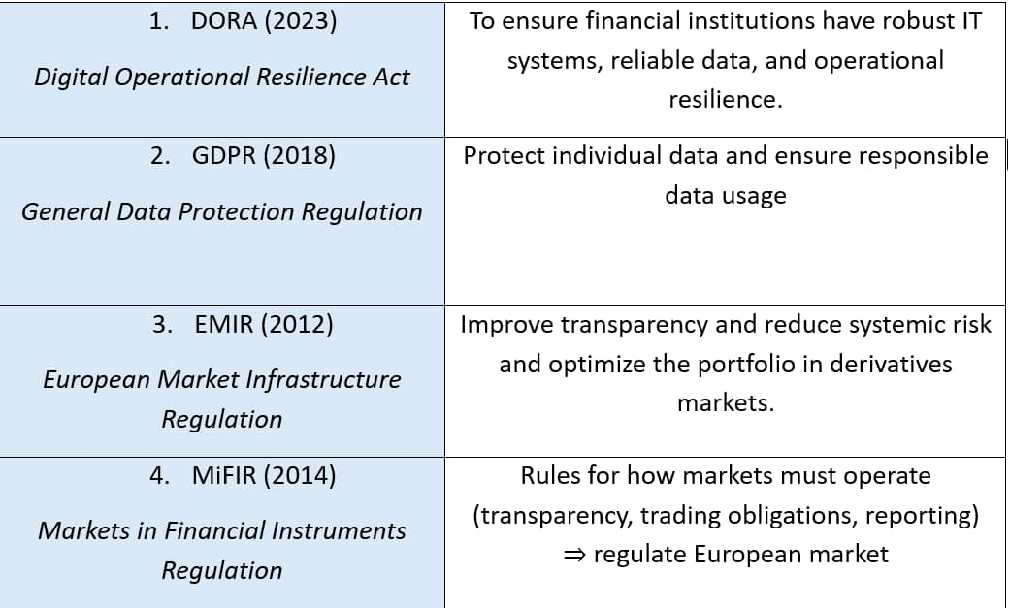

REGULATIONS ON AMUNDI’S DATA

Slide 7

THE IMPROVMENT
TECHNICAL SIDE :
Time series data base
graph data base
Automatic data quality checks
REGULATORY SIDE :
follow all the DORA rules
keep a better history of all changes made to the data
Better documentation and better traceability

Slide 8


THE DATA BASE
clean the data
remove errors
organize
add financial information

Slide 9

CONCLUSION

